Slide 1
Popular Library
State of North Carolina

Slide 2
Introduction
in this project we would like to solve the problem of finding the popular libraries in the state of North Carolina. North Carolina is known for its rich accessibility to all public libraries to the general users. The idea here is to identify all the popular libraries in the state. We will be also identifying different venues close to the library which will help the team to identify what is the best criteria to open a new library in a new location

Slide 3
Data
Data
We will start with use of different steps in data science methodology. Now that the business requirement is already laid, it is time to find the approach we are going to take to collect, understand, analyse and prepare the data. The first step include collecting the data making use of publicly available library dataset, foursquare api to get the location of the library, publicly available popular books dataset like New york best sellers list. We are going to scrap away the PII data and only keep the publicly available data during the stage of data preprocessing. Now we analyse the data make sure what are the individual fields/columns are relevance and remove the unwanted fields. we will convert the text column to int by using transpose method so that we can fit model on the data. During the whole process of analyzing the data , we will make use of different plots to understand the data to its depth
Dataset
Libraries in North Carolina
Popular books
Foursquare API

Slide 4
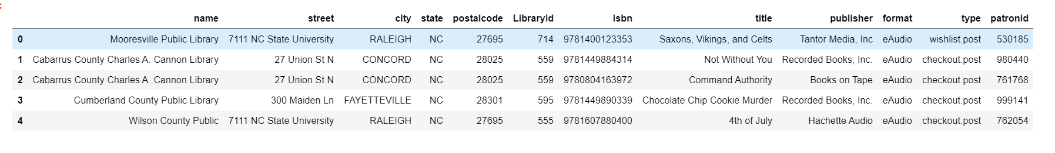
Data
Snapshot of libraries users in State of North Carolina
This is the public dataset which we are using for generating the model. This contains all the information of library location and books used by the different users as part of their digital catalog

Slide 5
Methodology and Analysis
Step 1
In this project we will direct our efforts on data collection, data preparation, generating a model, evaluating the model and finally plotting the data in the map to identify the popular library.
In this step, we are going to identify the unique postal code of all the libraries and then use the "geolocator" libraries to get the location information like latitude and longitude. this is necessary further to plot the location of the libraries in the map. We are going to do it in a separate data frame to avoid multiple hits to geolocator api thereby avoiding time-out issue. Next, we will merge the location data into the original data frame. We will only consider the relevant columns like name, postal code, longitude, latitude information and ignore all other columns

Slide 6
Methodology and Analysis
Step 2
In this step after the initial dataset is completed, we will have rough information of popular titles based on the no of checkouts information on each library. we will use that information to find the most popular library with help of dataframe.describe method. Next, we will use Foursquare api to find all the venues close to the popular library to identify what are the venues is helpful to decide whether a library is popular or not

Slide 7
Methodology and Analysis
Step 3
In this step we will be creating a model to identify the popular library. Since we need to find out whether a library is popular or not, it falls under category of binary classification(yes/no), so we would be using logistic regresssion to build a model and evaluate the dataset. We will use different evaluation technique like loggloss function, confusion matric etc to verify the results

Slide 8
Methodology and Analysis
Final Step
In the fourth and the final step, we will use the map to plot all the popular libraries in the state of North Carolina and use plot markers to mark the libraries with no of checkouts

Slide 9
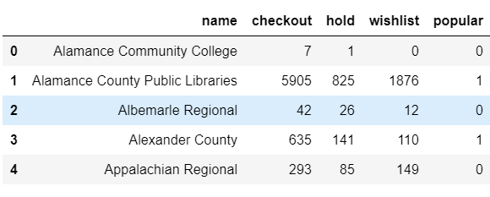
Final Dataset
This is the final dataset used for the model evaluation. We will be using StandardScaler preprocessing to bring all the row values close to each other thereby avoiding overfit of the model

Slide 10
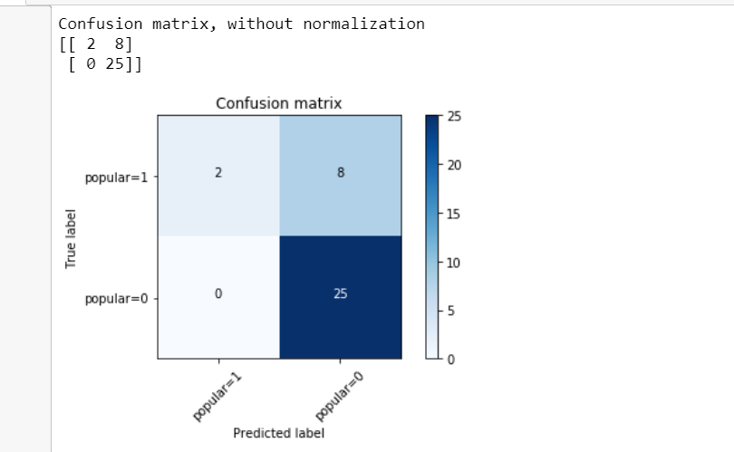
Confusion Matrix
Model evaluation using confusion matrix

Slide 11
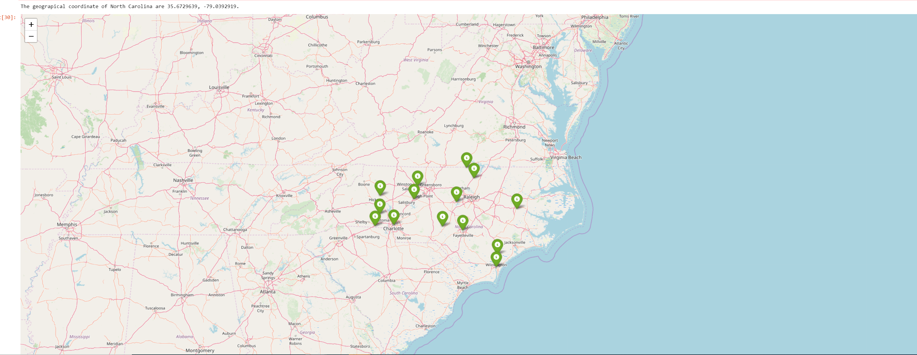
Map
This is the final dataset used for the model evaluation. We will be using StandardScaler preprocessing to bring all the row values close to each other thereby avoiding overfit of the model

Slide 12
Conclusion
Purpose of this project was to identiy the popular libraries in the state of North Carolina. We saw from the dataset that based on no of checkouts information we could analyse and get all the popular libraries , however that was not enough to be an optimal solutions, so we made use of data science and built a logistic regression model to evaluate the popular libraries and we identifed there are many factors like nearby venues that determine the popularity of the library. this result can be used by different stakeholders to build a new library in the state of North Carolina.

